Slide 1
Graduate Policies and Procedures
Best Practices: Steve Driese & Chris Rios

Slide 2
Results of Surveys of Baylor Ph.D. Programs
All XX units responded, and only a few did not have anything currently prepared
Variability of content between different units, ranging from professional booklets to handouts
Some, but not all, had their materials accessible online to students; seems logical to have digital documents available on-line
Most units regarded their handbook/documents as “current”, but some are currently under revision
Some newer Ph.D. programs are needing to get started on their documents

Slide 3
Best Practices
Clear academic expectations (coursework, research, exams, dissertations, etc.)
Clear expectations for professionalism (relationships with faculty and peers, interactions in labs and classrooms, etc.)

Slide 4
Best Practices
Statement about University Resources, especially Title IX and OALA
Regular student evaluation and feedback

Slide 5
Stepwise Process of Building a Policy & Procedures Document/Handbook
Step 1: GPD and Dept. Chair create draft
Include Timetable and Process for Advising, Committee Formation, Defense of Dissertation Proposal, and Dissertation Defense
Include Timetable and Process for Administering Preliminary & Qualifying Exams
What are Annual Metrics for Evaluating Forward Progress?
What are Consequences of Insufficient Progress?
Step 2: Vetted through Graduate Faculty
Does this represent Department’s current policies & procedures?
Task description
Task description
Step 3: Link to Dept. website
Task description
Task description
Step 4 Introduce at Graduate Student Orientation
Task description
Task description

Slide 6
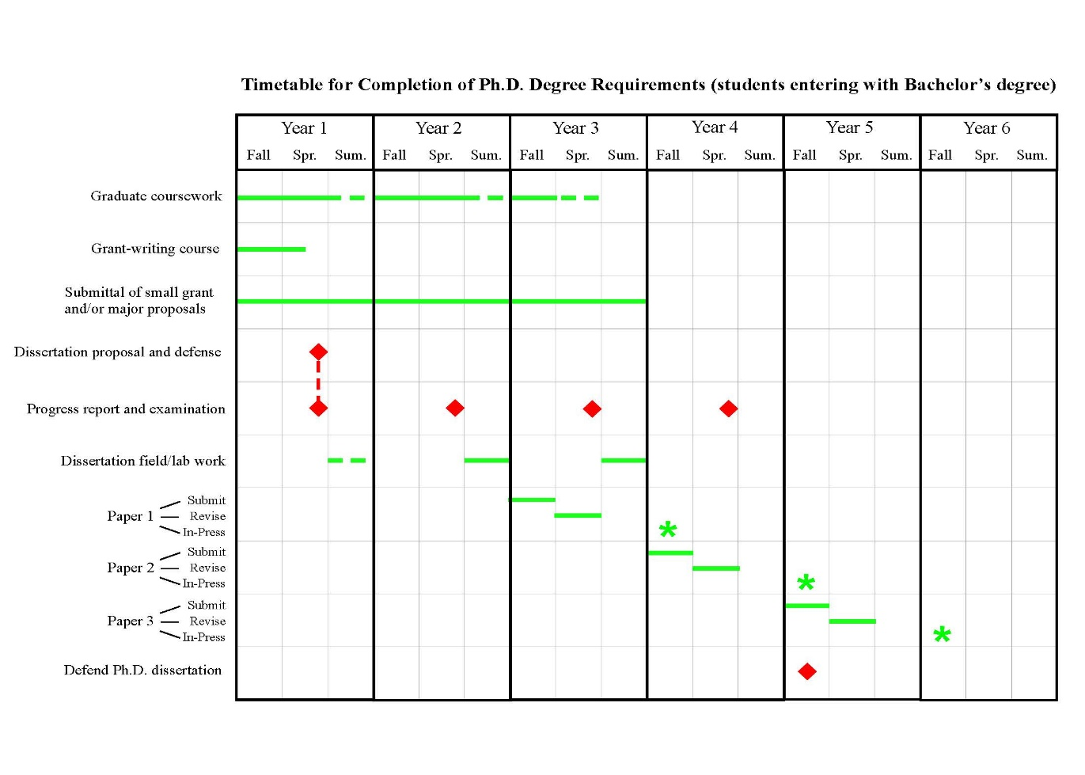
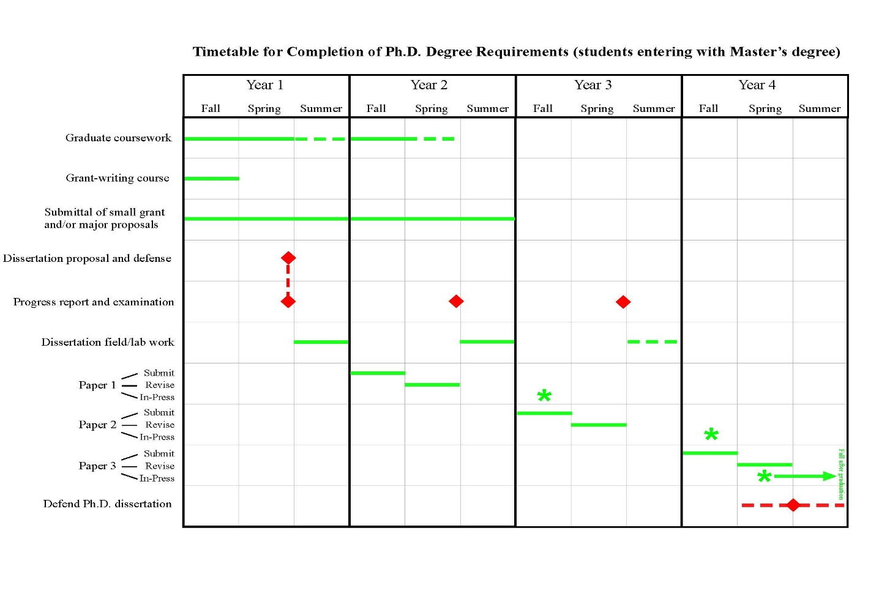
Examples of Benchmarks for Annual Review of Ph.D. students
GEO for students entering with MS
GEO for students entering without MS

